Slide 1
SERFF Modernization Proof of Concept
Recorded Demo and Overview

Slide 2
In This Deck
The purpose of this slide deck is to give interested parties an opportunity to view a recorded demo of a proof of concept developed to support a project to modernize the SERFF application.
Some context is provided to help viewers understand the scope of the proof of concept in relation to the overall modernization project. Additional information and resources are being prepared to provide visibility into the modernization project for all stakeholders and interested parties.
Questions on the project or the proof of concept can be directed to bkieras@naic.org.

Slide 3
Proof of Concept Overview
The proof of concept (PoC) demonstrated in the upcoming recording was a deliverable of the Mobilization and Pilot phase of the SERFF Modernization project.
For the PoC, use cases were identified and developed to demonstrate key functionality capabilities for a modernized platform. The use cases were designed to showcase how the future architecture will deliver desired functionality, particularly related to tools like content management, business process management, and robotic process automation.
The proof of concept was meant to be representative of future state needs and is not a comprehensive demonstration of the entire SERFF system, either now or in the future.

Slide 4
Core Capabilities
The proof of concept demonstrates these core capabilities to be delivered in the future system:
    • Self-service customizations by system users
    • Upfront validations while preparing and submitting filings
    • In-depth filing review supported by document analysis and business rules
    • Tools to support communication and collaboration across users
    • Integration with other NAIC products and business partner platforms
    • Efficient and visible workload management
    • Robust search capabilities and reporting
    • Enhanced platform architecture via AWS cloud-based tools and services
    • Content management and decision-making capability

Slide 5
Recorded Demo of PoC
Click the play button on the next slide to watch the demonstration of the proof of concept as given to the SERFF Product Steering Committee.

Slide 6
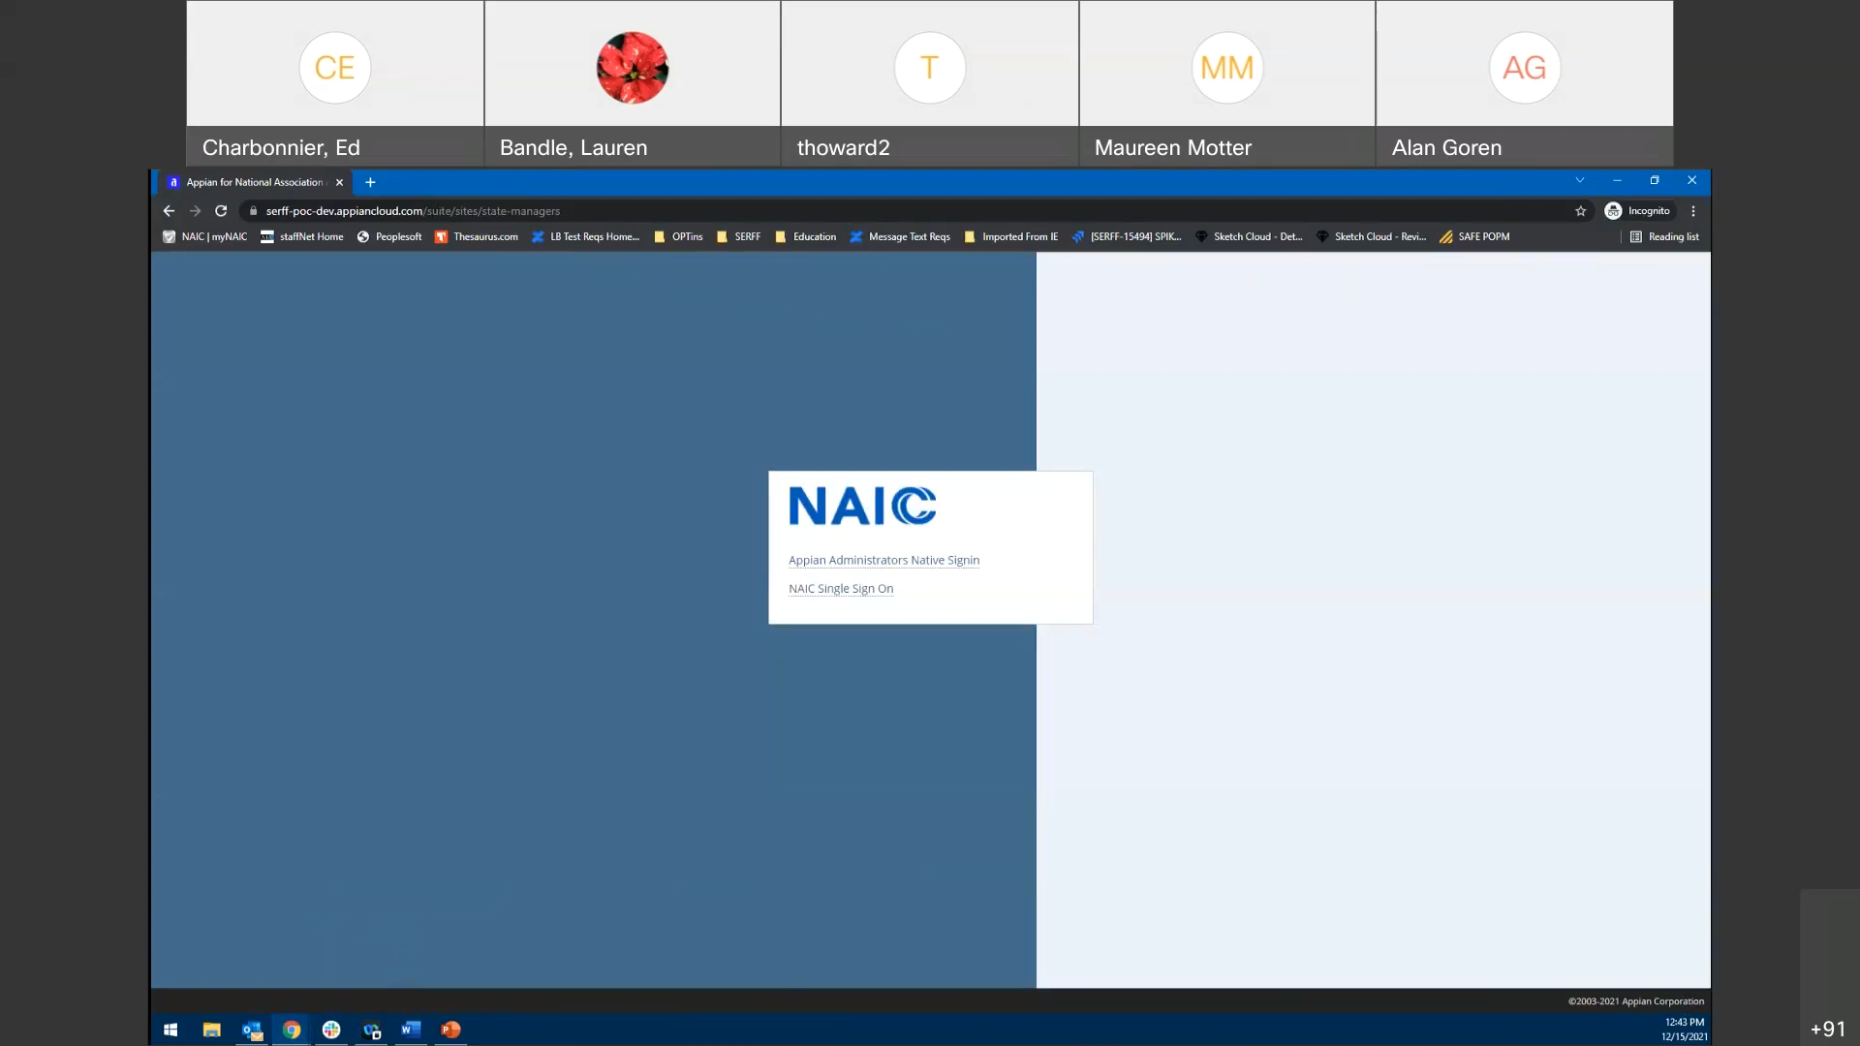

Slide 7
Conclusion
The PoC in this deck was not intended to be production ready code and will not be released to users.
The SERFF Modernization project has been approved by NAIC and will begin in Q2 2022. It is estimated to be a three year project delivered in multiple phases.
Further information on the project is being prepared to help users, stakeholders, and interested parties understand and anticipate impact.
Questions on the project or the PoC can be directed to bkieras@naic.org.

