Slide 1

SERFF Product Steering Committee
November 19, 2025
Recording link: https://naic.webex.com/naic/ldr.php?RCID=b8e2a4cdfaa4cb128203405646bf3c83

Slide 2
PSC Membership Turnover
2025 Turnover:
2026 Appointments:
Rosemary Raszka, VT
Kris Fabian, CT
Connie Van Slyke, NE
Ken Williamson, AL
Cecily Garris, Delta Dental
Maureen Motter, OH
Tom Zuppan, AZ
Beverly Brand, CA
Jillian Wallin, Allianz
1 State Seat Pending Response
1 State P&C Seat Open

Slide 3
Roll-Call
• Roll will be called for current PSC members only
Membership turnover is in progress
• Interested parties who called in and wish their attendance to be recorded can email adysart@naic.org

Slide 4

Agenda
Development Update
Open Q&A (Menti)
2025 / 2026 Meeting Dates

Slide 5
Development Update

Slide 6
Development Update
Continuing to address production support issues
Building out enhancements and new features for state and industry based on feedback.
Continuing development of the state filing functionality for Early Adopters

Slide 7
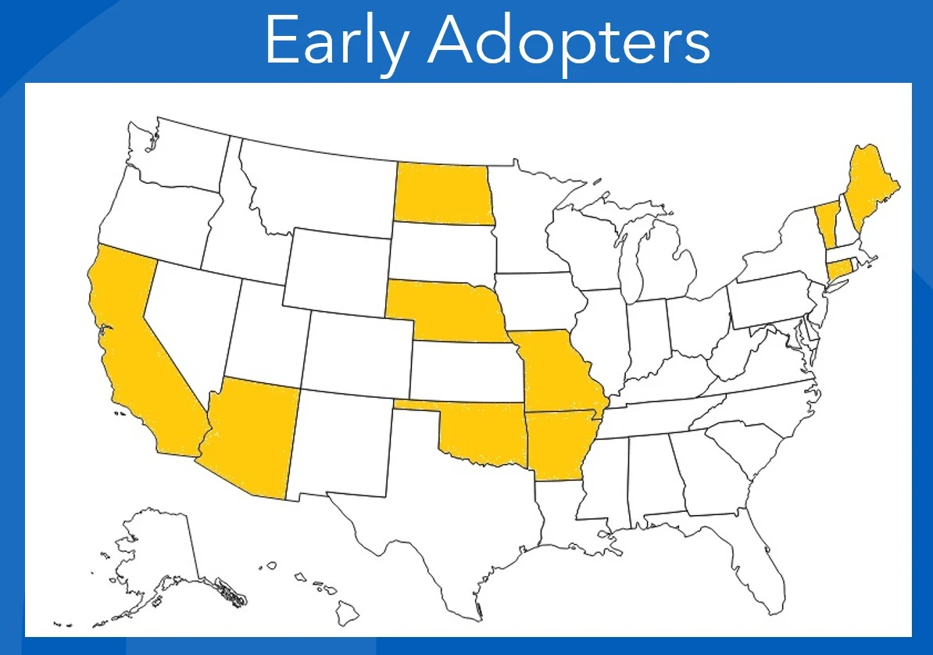
Early Adopter States
Arizona – P&C and LAH
Arkansas – P&C and LAH
California – LAH
Connecticut – P&C
Maine – P&C
Missouri – P&C
Nebraska – P&C and LAH
North Dakota – P&C and LAH
Oklahoma - LAH
Vermont – P&C

Slide 8
Co-Existence & Transition Timelines
EA states may have different transition dates
Many users will operate in both systems for a time
Both system will have messaging and tools to help guide users
Early adopters will inform next steps and the longer-term roadmap

Slide 9
Open Q&A
Menti

Slide 10
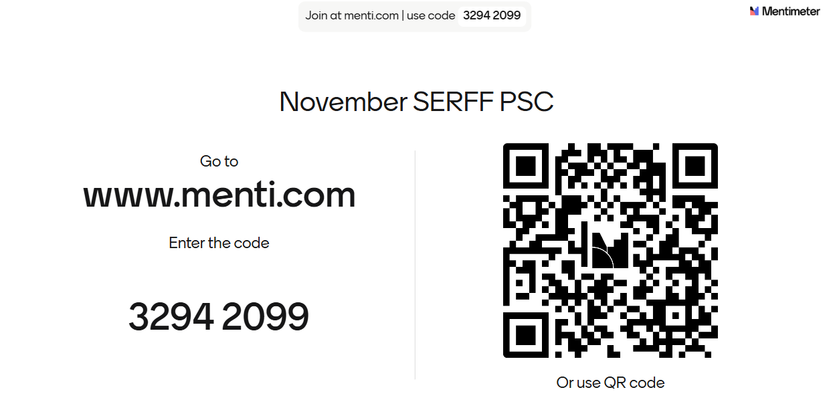

Slide 11
2025 Meeting Dates
December 17*
*Off typical cadence due to holiday.

Slide 12
2026 Meeting Dates
January 28
February 25
Tuesday, March 31
April 22
May 27
June 24
July 22
August 26
September 23
October 28
November 18
December 16

Slide 13
Questions?
serffmodernizationquestions@naic.org

