Slide 1

SERFF Product Steering Committee
January 28, 2026
Recording Link: https://naic.webex.com/naic/ldr.php?RCID=4e711059af12a81cae2e088c4a563194

Slide 2
Roll-Call
• Roll was not verbally called for this meeting due to an issue with the Webex Webinar. Attendance was recorded via the Webex participant panel.
• Interested parties who called in via phone and wish their attendance to be recorded can email adysart@naic.org

Slide 3

Agenda
Development Update
Okta Implementation Update
Open Q&A
State Topic - Adhoc Reporting

Slide 4
Development Update

Slide 5
Development Update
Performance Optimization
Quick Wins:
  Amendment views default to schedule items with open compliance issues
  Find Filings: Saved Searches, Company Name column
  Declined Compliance Issues: Reviewer decline comment will now display in the task body
Upcoming:
  More Find Filing improvements
  Moving the instance switcher
More updates next month

Slide 6
SERFF's Okta Implementation

Slide 7
SERFF's Transition to Okta
SERFF implemented NAIC Single Sign On as an optional login method last fall.
Our support team has been working to gradually transition users.
Over the next six weeks, Okta will become the only login method.

Slide 8
What is Okta?
A cloud-based identity and access management tool. This isn't an NAIC product.
Okta will be how you log in to SERFF and other NAIC systems.
Okta will also manage some of your personal information and your password.
If your company uses Okta – it's not the same "tenant" which means it's not the same ID/password.
Okta includes multi-factor authentication to improve security.

Slide 9
What Happens Next?
Try logging in with Okta the next time you access SERFF.
Watch for emails and SERFF Alerts!
Be patient!

Slide 10
Open Q&A
(Menti)

Slide 11
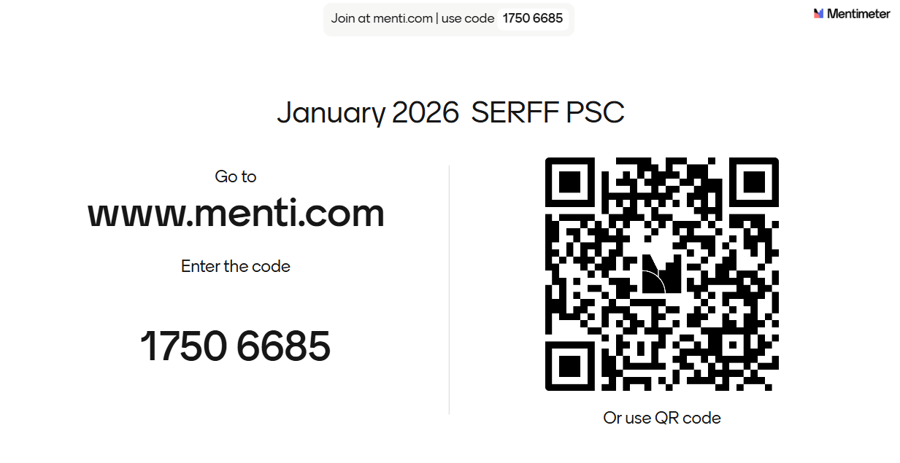

Slide 12
Adhoc Reporting –
State Only
If you are a State regulator and wish to receive Diane's Adhoc Reporting slides or this segment's recording, please contact adysart@naic.org

Slide 13
Snowflake State Shared Account - SERFF
How Can You Access the Data?
  User Connections
  Application Connections
What Data is Available?
  All years
  Legacy; SERFF Mod coming with Early Adopter Implementations
  Not all data elements yet; state input and prioritization drives additional data objects
Purpose of the Shared Account
  Share the SERFF data in a simplified model to allow analytics and reporting

Slide 14
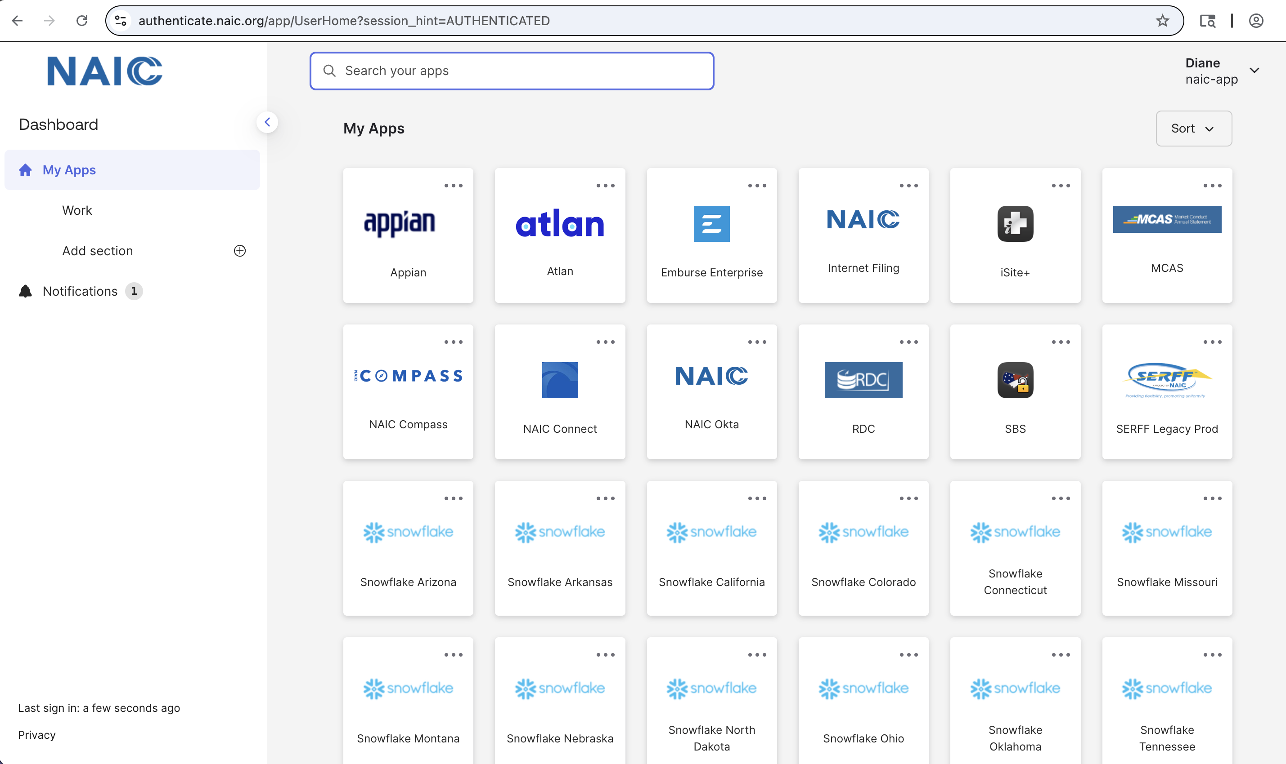
User Connection Walk Thru

Slide 15
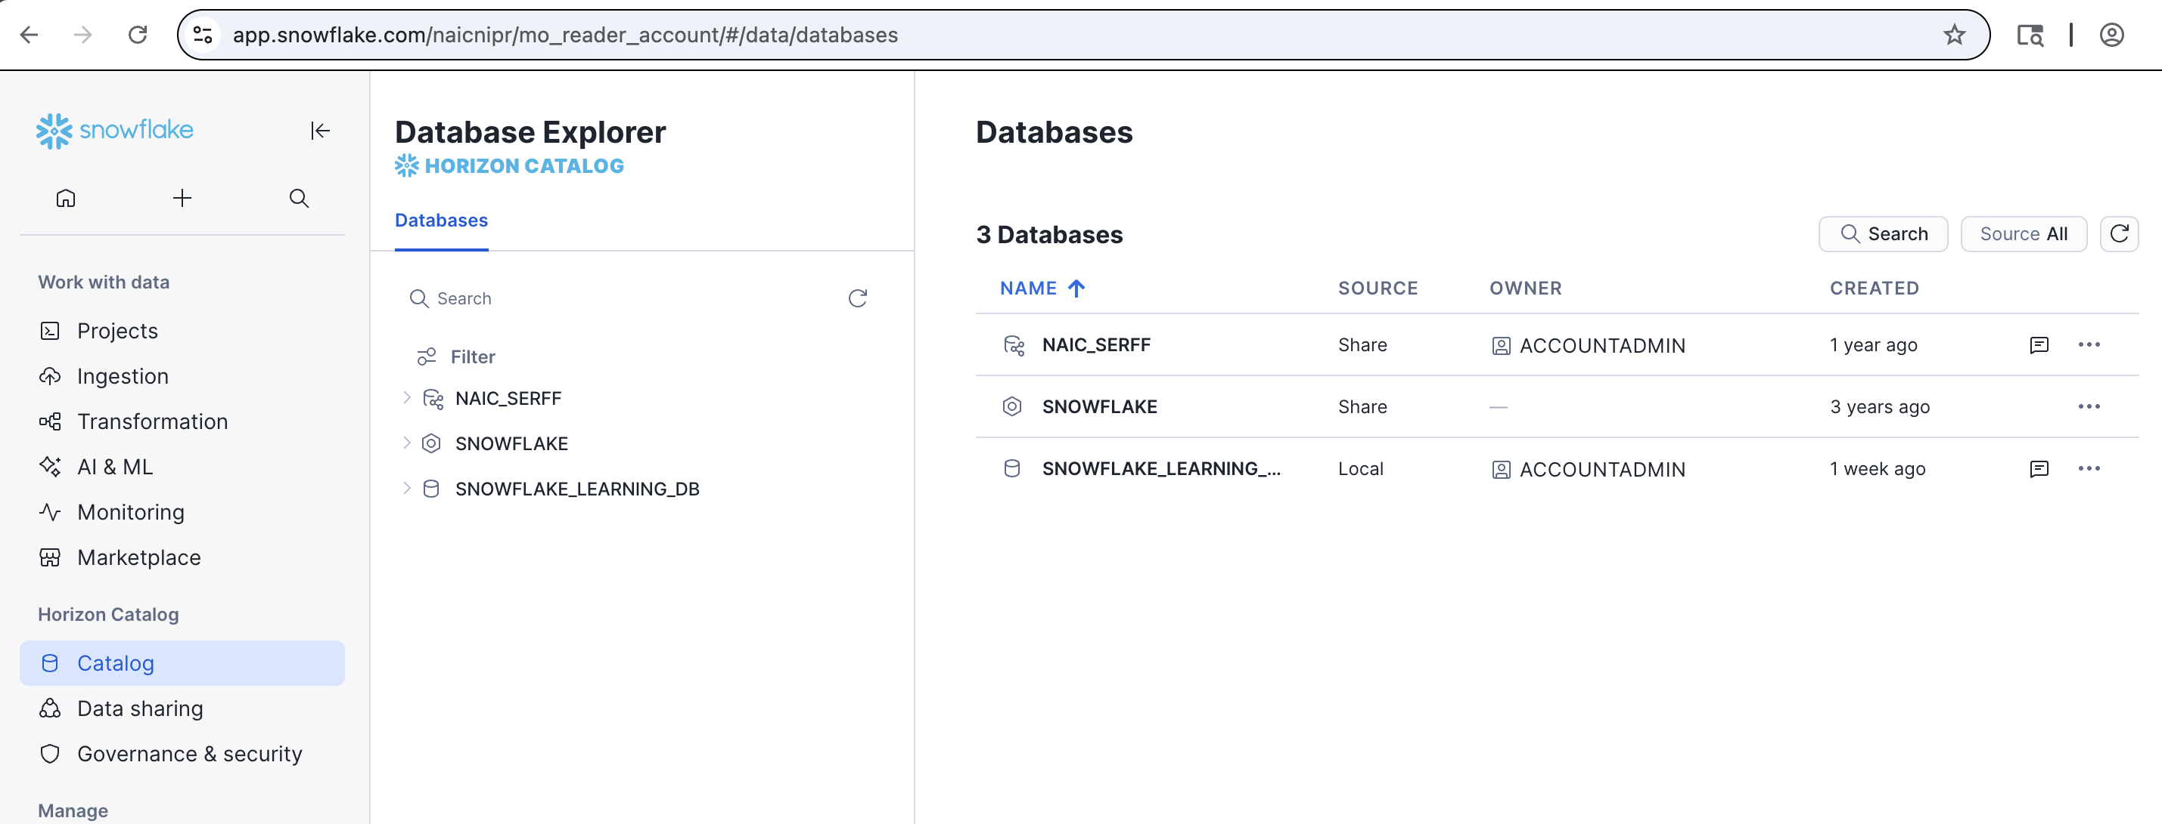
User Connection Walk Thru

Slide 16
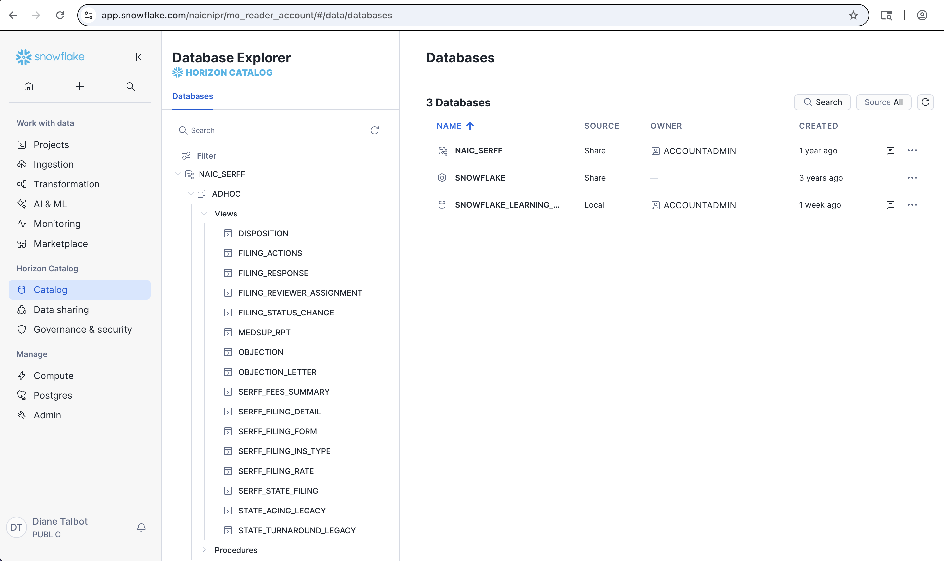

Slide 17
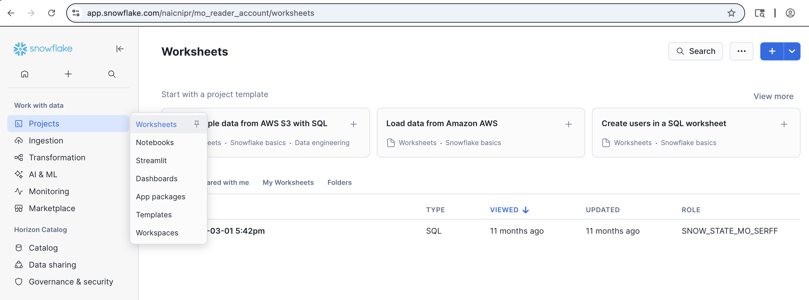
User Connection Walk Thru

Slide 18
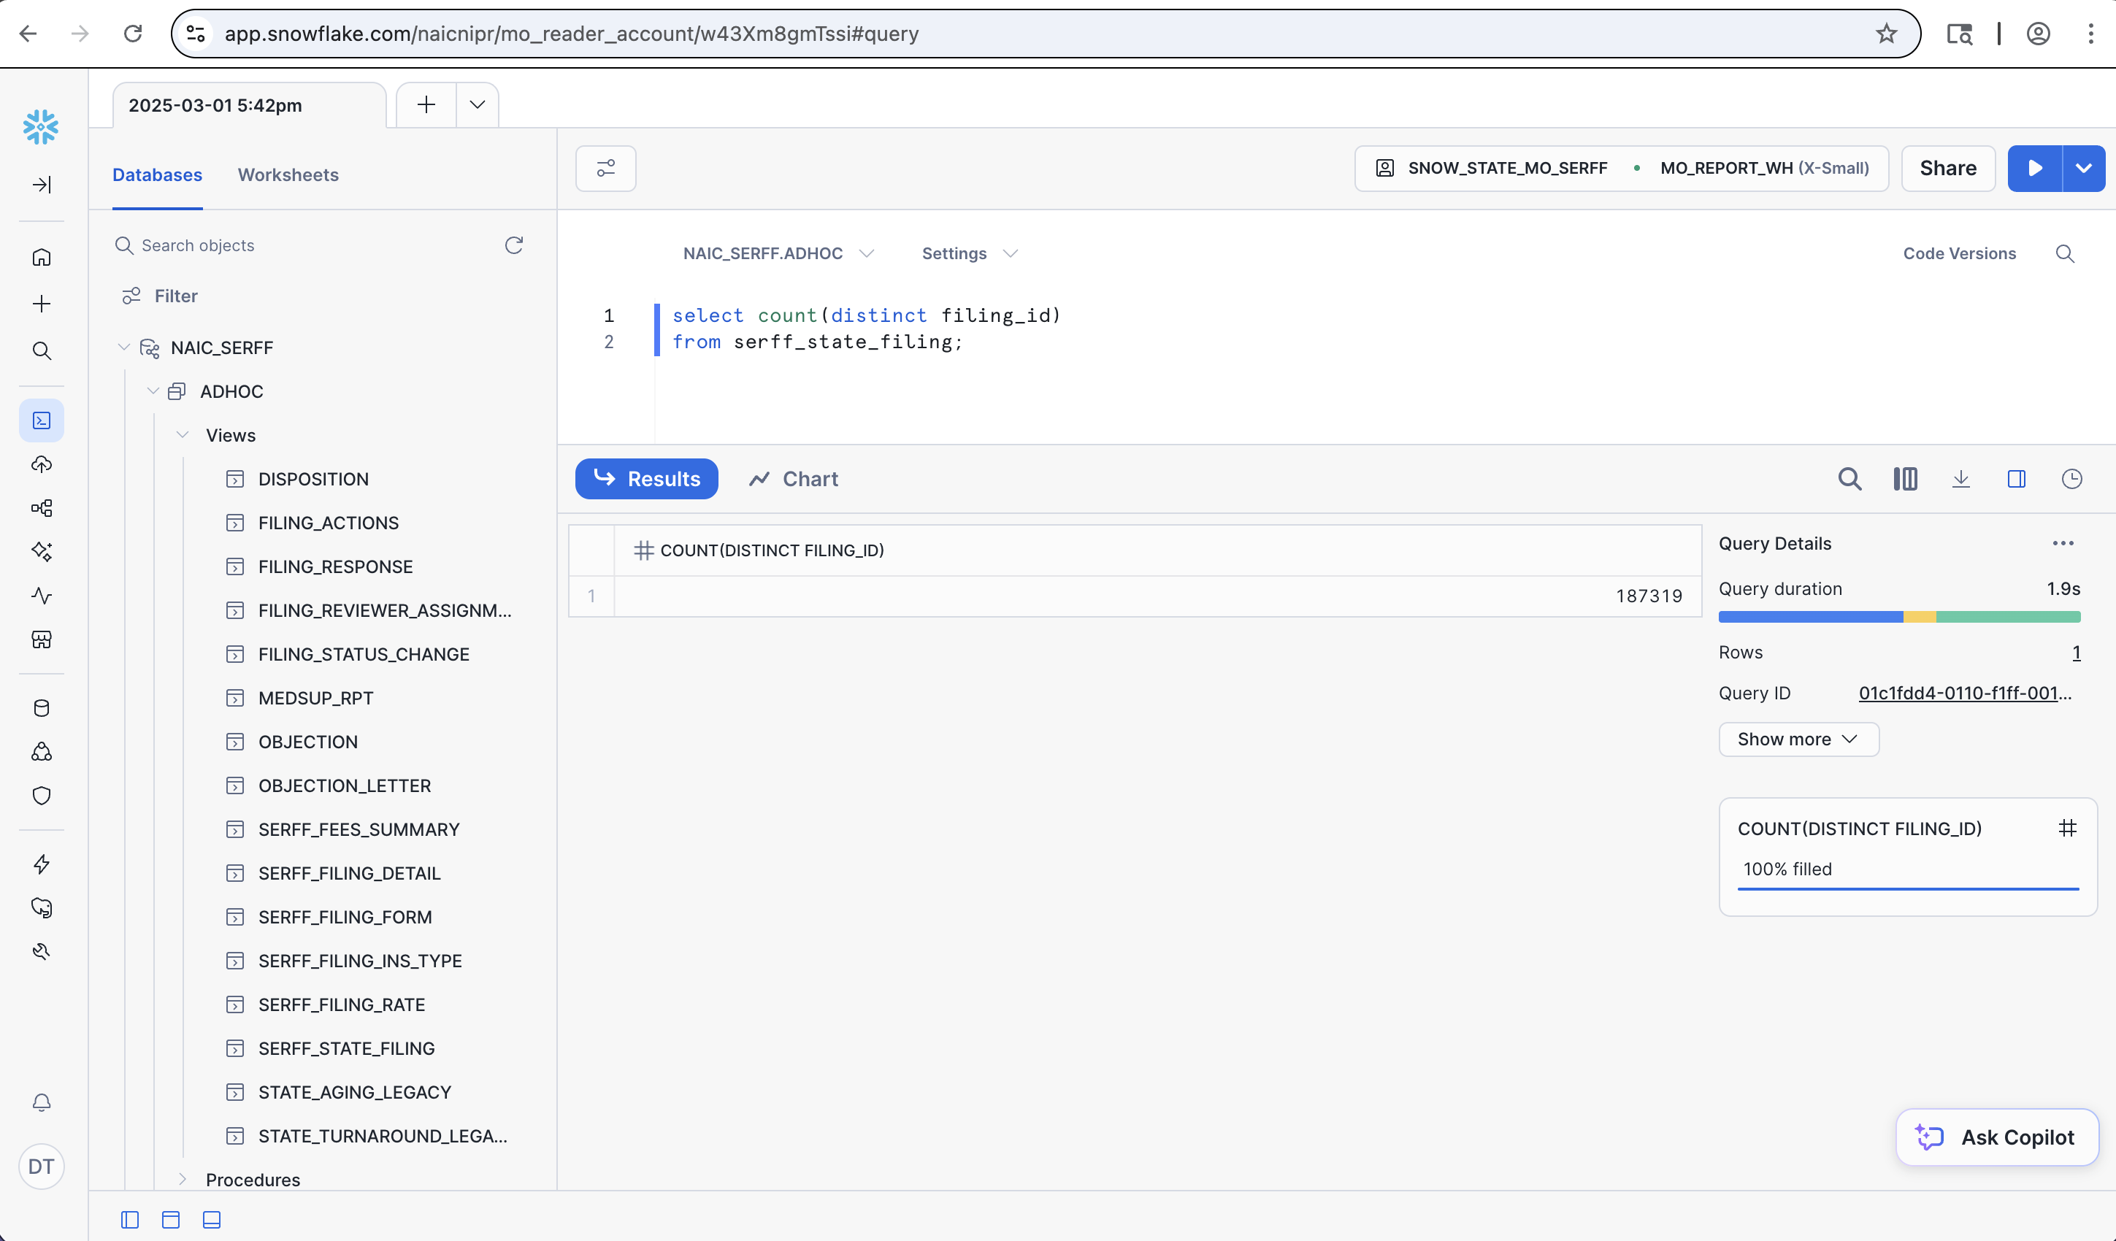

Slide 19
SERFF Data – Application Connections
Excel
Access
PowerBI
Crystal Reports
Tableau

Slide 20
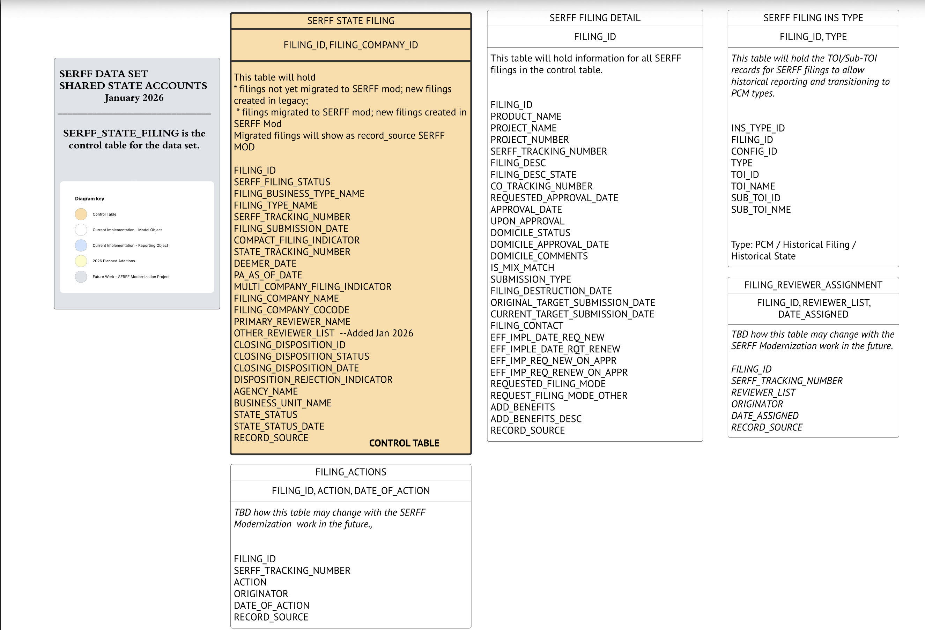
SERFF Data – Model and Reporting Objects

Slide 21
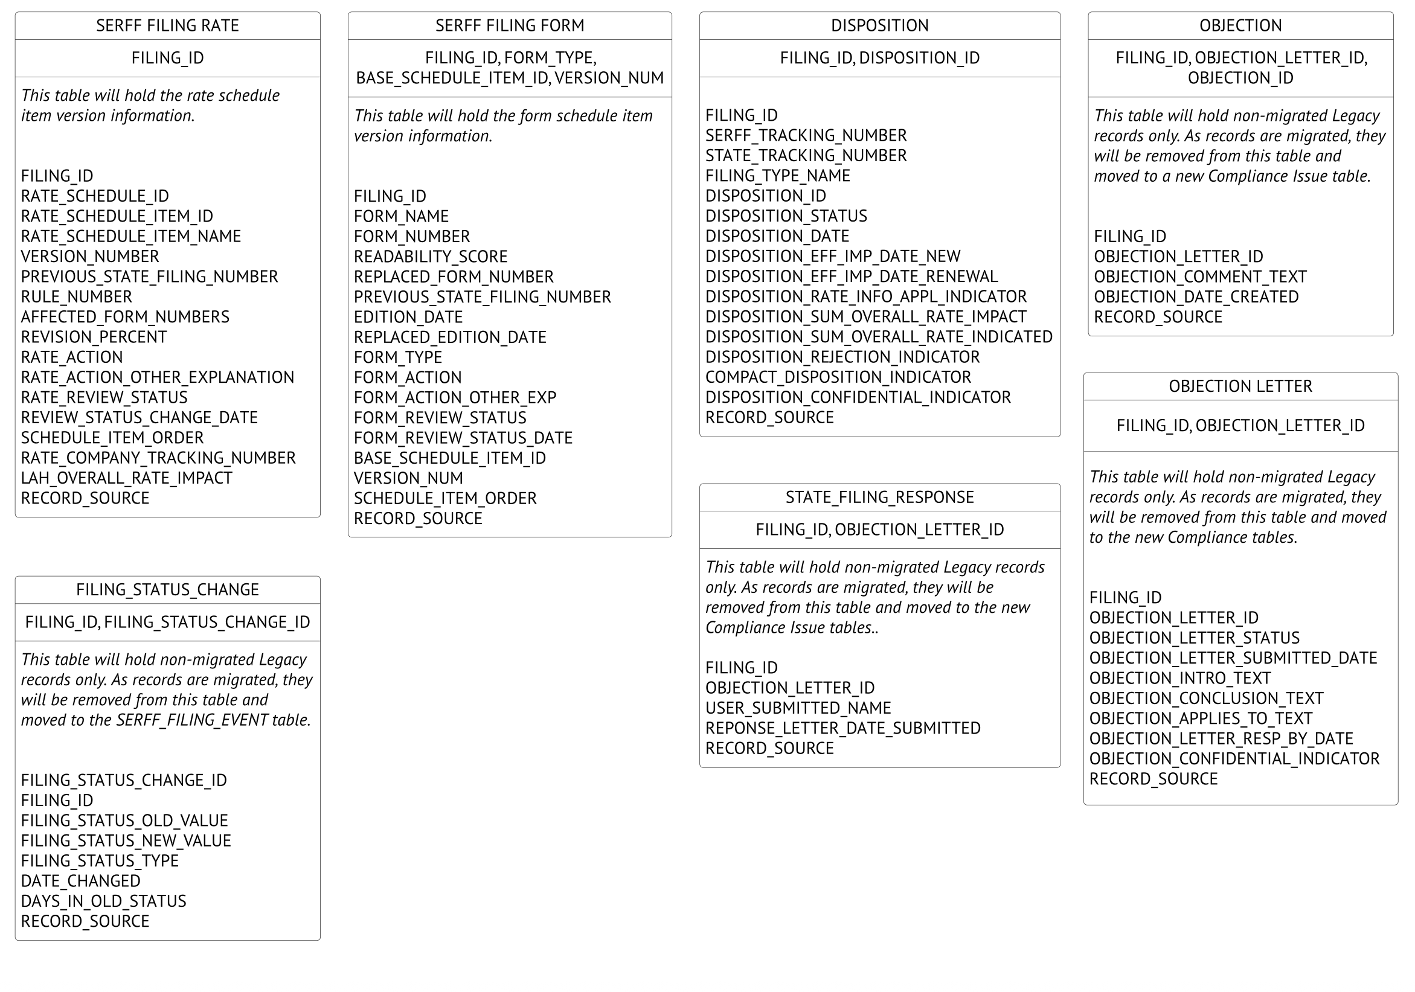
SERFF Data – Model and Reporting Objects

Slide 22
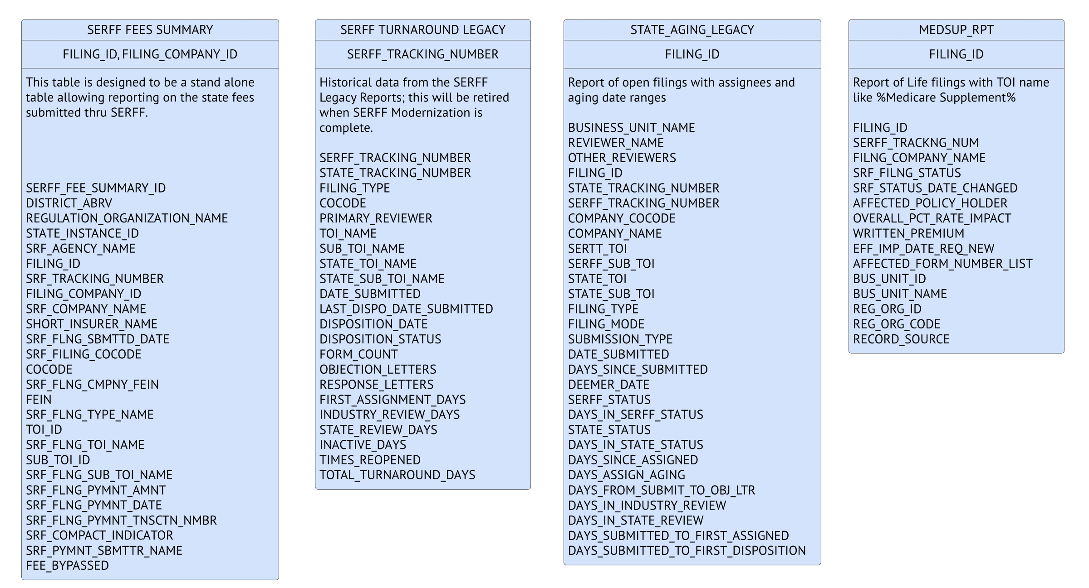
SERFF Data – Model and Reporting Objects

Slide 23
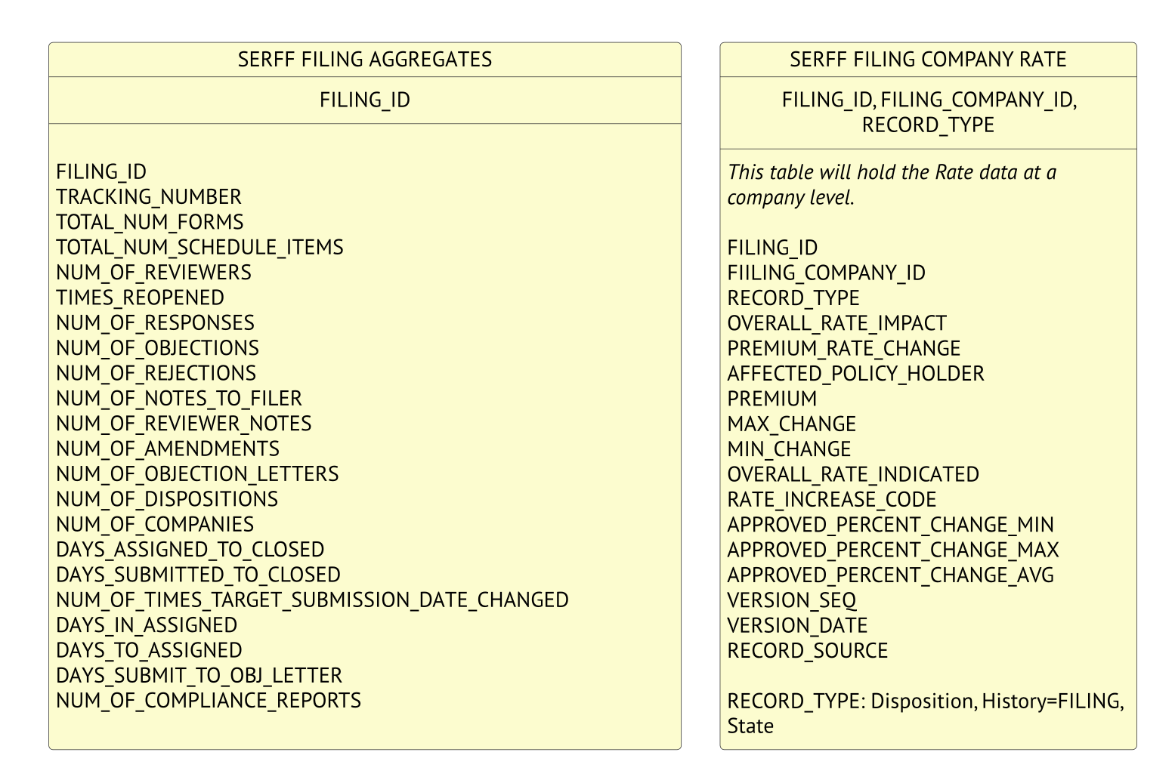
SERFF Data – Model and Reporting Objects

Slide 24
Snowflake State Share - SERFF
Do you want to get started with Snowflake?
Do you have reporting needs that Snowflake can help meet?
Let us help!!

Slide 25
Snowflake State Share - SERFF
Contact:
serffmodernizationquestions@naic.org

Slide 26
2026 Meeting Dates
February 25
March 31
April 22
May 27
June 24
July 22
August 26
September 23
October 28
November 18
December 16

Slide 27
Questions?
serffmodernizationquestions@naic.org

